Slide 1
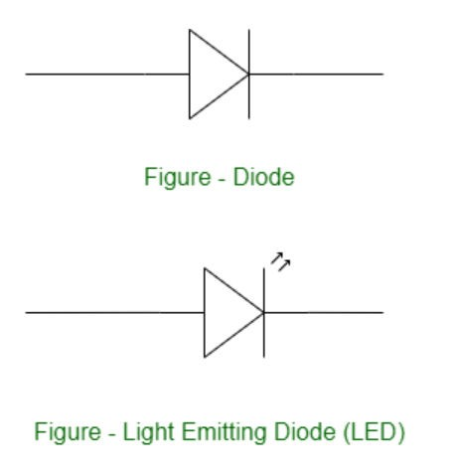
Programming and connection: Blinking LED & Fading LED
LEDs (Light Emitting Diodes) are becoming increasingly popular among a wide range of people. When a voltage is given to a PN Junction Diode, electrons, and holes recombine in the PN Junction and release energy in the form of light (Photons). An LED’s electrical sign is comparable to that of a PN Junction Diode. When free electrons in the conduction band recombine with holes in the valence band in forward bias, energy is released in the form of light.

Slide 2
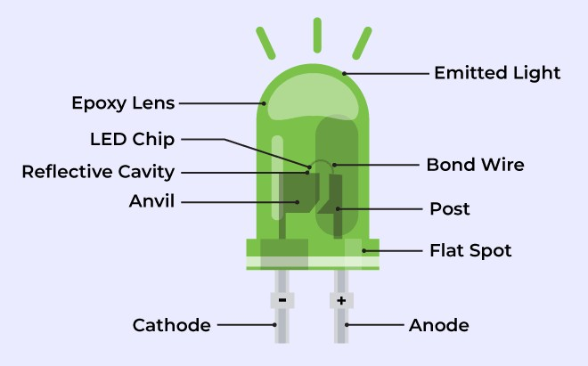
Structure of an LED
The flow of charge carriers (electrons and holes) across the P-N junction drives the activity of an LED. When a forward voltage (anode positive in comparison to the cathode) is applied, electrons and holes recombine at the junction, releasing energy in the form of photons (light).

Slide 3
The semiconductor chip is linked to external terminals known as the anode (+) and the cathode (-). The anode is linked to the P-region, and the cathode to the N-region.
Blinking an LED
Blinking an LED is an introductory Arduino project in which we control an LED using Arduino. LED blinking refers to the process of continuously turning an LED (Light Emitting Diode) and off in a repetitive pattern. It is a simple and common demonstration in electronics and microcontroller-based projects.
Working Procedure
setup() and loop() are two fundamental Arduino functions for controlling the behavior of your board. The Arduino framework automatically calls these functions, which form the foundation of any Arduino program.

Slide 4
The setup() function is only called once when the Arduino board boots up or is reset. Its goal is
to set pin modes, initialize variables, and execute any other necessary setup tasks before the main loop begins. This function can be used to configure settings that should only be changed once over the board’s lifespan.
The loop() function is the heart of an Arduino program. After the setup() function is executed,
the loop() function starts running repeatedly until the Arduino is powered off or reset. It contains the main code that performs the desired tasks, controls the board, user input. Whatever is included in the loop() function will be executed in a continuous loop, allowing the Arduino to perform its intended functions continuously.
In the code, we have declared two integers, LEDpin and delayT. LEDpin represents the pin number of the Arduino where LEDs need to be connected, and delayT is an integer variable for the delay() function. The delay() function accepts values in milliseconds.

Slide 5
Components Required
1 × LED
1 × Resistor, 330 Ohm
Breadboard
Arduino UNO R4 or earlier versions.
Jumper wires
Components Description
1 × LED: We are controlling only one LED in this program.
1 × Resistor, 330 Ohm: For every LED, we need one current limiting resistor.
Breadboard: A breadboard is a fundamental tool used in electronics and prototyping to build and test circuits without soldering.
Arduino UNO R4 or earlier versions.
Jumper wires: Jumper wires are simple electrical wires with connectors on both ends used to create connections between various electronic components or points on a circuit on a breadboard.

Slide 6
Arduino Code
int LEDpin = 13;
int delayT = 1000;
void setup() {
// put your setup code here, to run once:
pinMode(LEDpin, OUTPUT);
}
void loop() {
// put your main code here, to run repeatedly:
digitalWrite(LEDpin, HIGH);
delay(delayT);
digitalWrite(LEDpin, LOW);
delay(delayT);
}

Slide 7

Deployment Using Arduino IDE

Slide 8
Circuit Diagram
In the circuit diagram, we used one 330-ohm resistor in series with the LED. This resistor is also
called a current-limiting resistor. The Anode of the LED (the longer pin) is connected to one end of the resistor, and the cathode (the shorter pin) is connected to the ground. The other end of the resistor is connected to the Arduino pin. A step-by-step explanation is as follows:
1. LED Connections: Connect the LED to the breadboard. The LED has two legs, the longer of which is the anode (positive) and the shorter of which is the cathode (negative).
Resistor Connection: Insert one end of the resistor into the same row of the breadboard as the LED’s Anode. The resistor’s other end should be connected to the Arduino’s digital output pin.
Ground (GND) Connection: Connect a jumper wire from the same row as the LED’s
cathode to any Arduino board GND (Ground) pin. This connects the circuit to the ground of the Arduino.

Slide 9
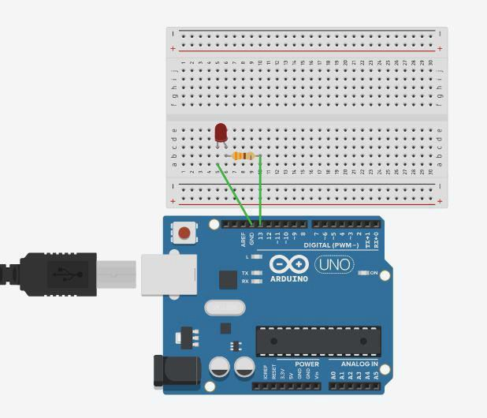
The circuit is now complete. Here’s how it works:
When you upload a simple Arduino program that controls the LED, the microcontroller on the Arduino board executes the program, and the LED will blink according to the code you wrote.

Slide 10
Applications and Uses of LED Blinking
The LED blinking project is an important and straightforward method that can be utilized for a
wide range of applications in microcontroller-based projects like:
Security Systems: To check the status of security systems
Warning Signals: In battery-operated devices, LED blinking can be used to indicate low battery levels.
In Testing and debugging.
Status Indication: LEDs can be used to indicate different states of a system. For example, in a home automation project, an LED might blink to indicate whether a device is connected to an internet network or not.

